Slide 1

MINOR PROJECT - III ON SP AUTOMOBILES (MCA – SEMESTER 3; BATCH 2021-23)
Internal Guide
Dr. Parul Arora (Associate Professor, BVICAM).
Dr. Vaishali Joshi (Associate Professor, BVICAM).
Mr. Manish Kumar(Associate Professor, BVICAM).
Presentation by
Tushar Sharma(35411604421)
Parikshit Soni (03735304421)
Simran Gulati(01335304421)
28 January, 2023
Notes:
1

Slide 2
Contents
Problem Description
Aim and Objective
Team role
Methodology and Technology Used for Project Development
System Design (Use Case, Data Flow Diagram, Entity-Relation Diagram)
Screenshots of running project
Testing of Project
Conclusion
Future Scope
Bibliography

Slide 3
Problem Description
Due to increase in sale of motorbikes and scooters SP Automobiles thought of having a web based application to provide booking service feature and spare parts online.
Also while waiting in long queues to get their vehicle serviced people were getting irritated so SP Automobiles provided their customers with easy online booking options .
And if mechanic isn’t available or if he/she got way too many customers on a single day then it would a bummer for everyone.
Also people can buy spare parts for their vehicle at reasonable price and get it fixed hand to hand on their visit to the workshop.

Slide 4
Aim and Objectives
Aim:
To develop a web-based application for SP AUTOMOBILES
Objectives:
To design of a relational database for managing appointments, products, users, mails and to order spare parts.
To design user-friendly interfaces to interact with the system.
To develop a better web based application according to user’s requirement.
To test the developed system.

Slide 5
Team Role
TUSHAR SHARMA
Database Management
PARIKSHIT SONI
Back-end development
SIMRAN GULATI
Front-end development

Slide 6
Methodology and Technology Used
Methodology used for Project Development:
Agile Methodology
Technology used for Project Development:
Front-End: HTML , CSS , JavaScript
Back-End: Node.Js, Express Js, JavaScript
Integrated Development Environment (IDE): VS Code
Database: MySQL Workbench
Web Server: Node.Js

Slide 7
SYSTEM DESIGN

Slide 8
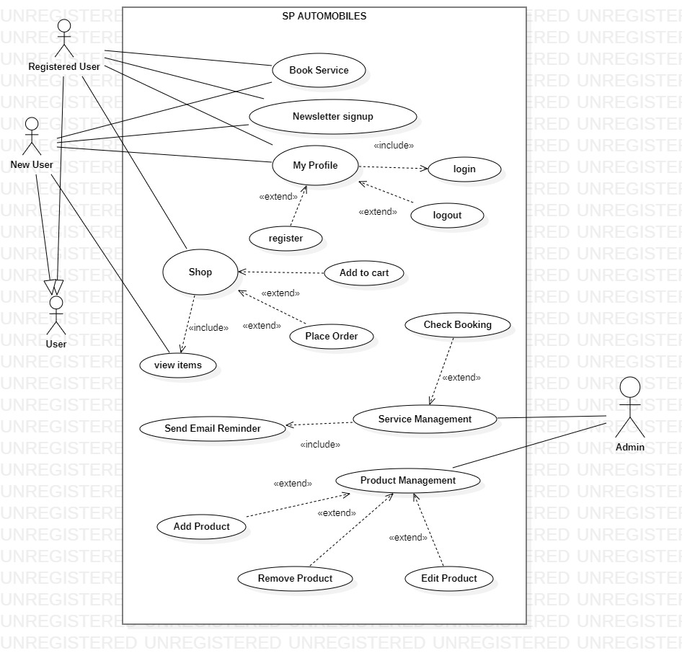
Use Case Diagram

Slide 9
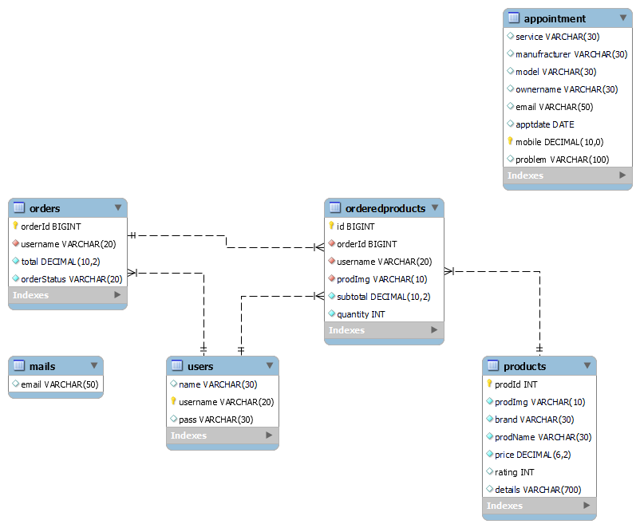
Entity-Relationship (E-R) Diagram

Slide 10
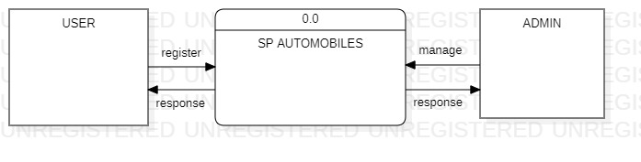
Data Flow Diagram (Level - 0)

Slide 11
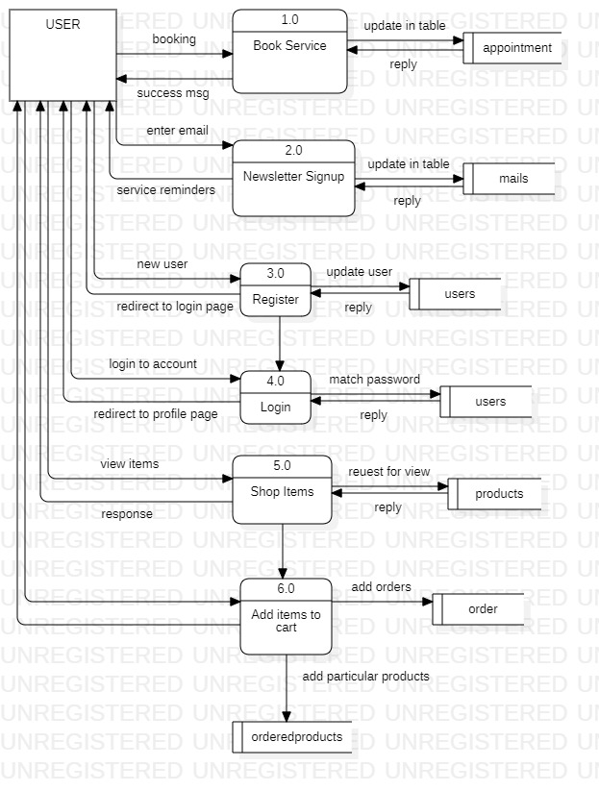
Data Flow Diagram (Level – 1 USER)

Slide 12
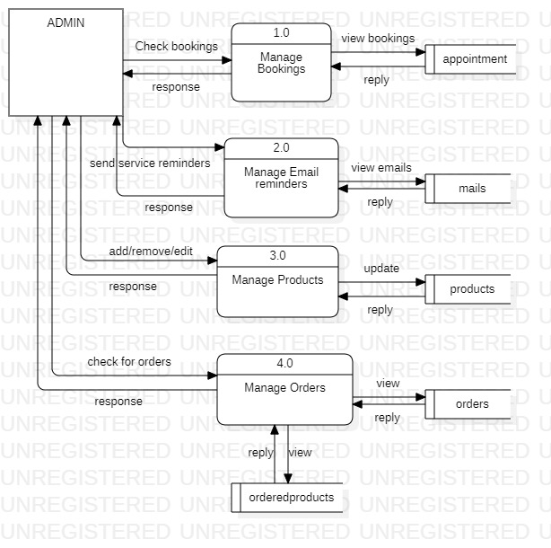
Data Flow Diagram (Level – 1 ADMIN)

Slide 13
SCREENSHOTS OF RUNNING PROJECT

Slide 14
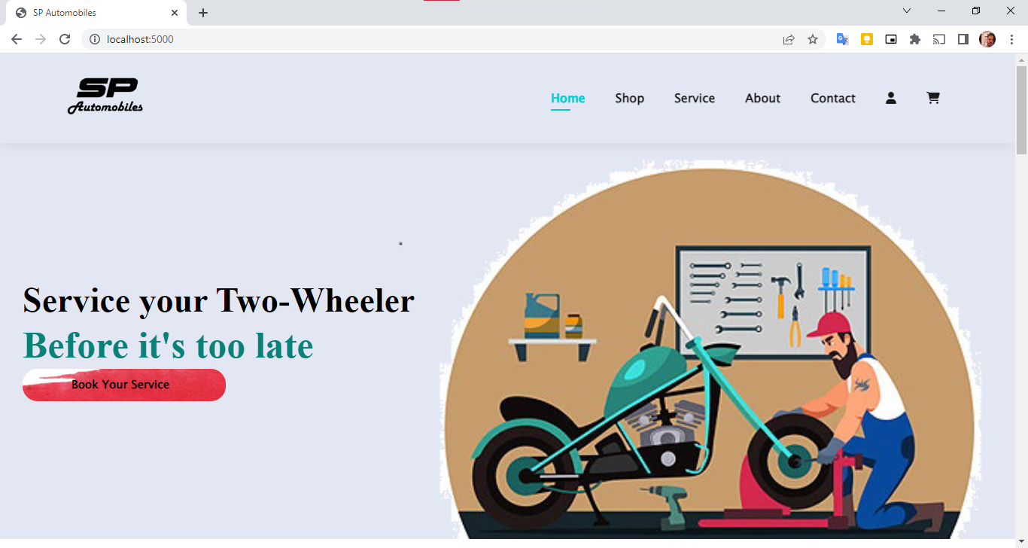
Home Page

Slide 15
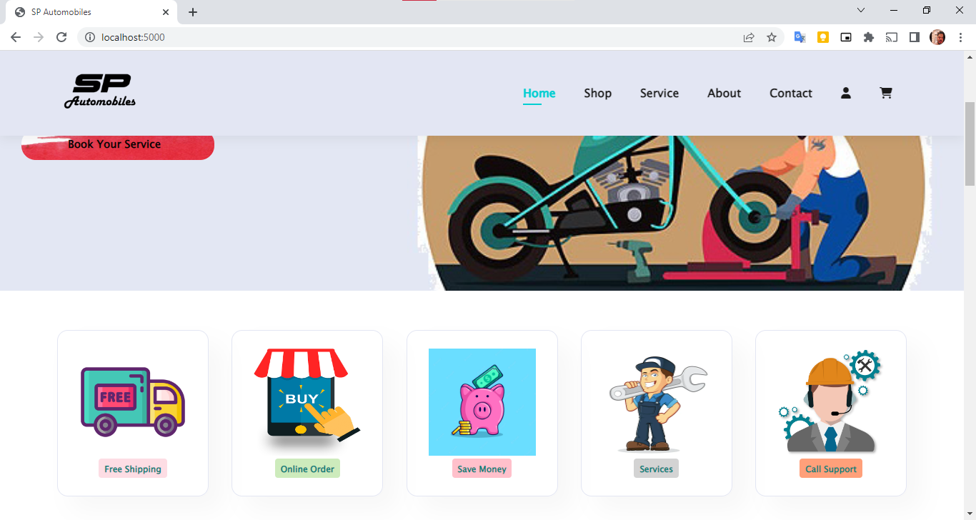
Home Page

Slide 16
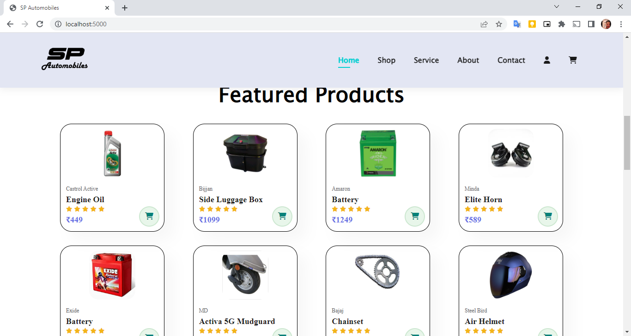
Home Page

Slide 17
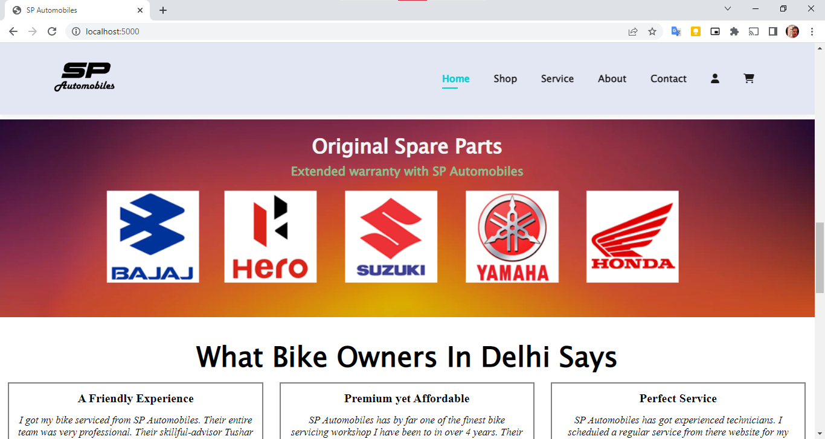
Home Page

Slide 18
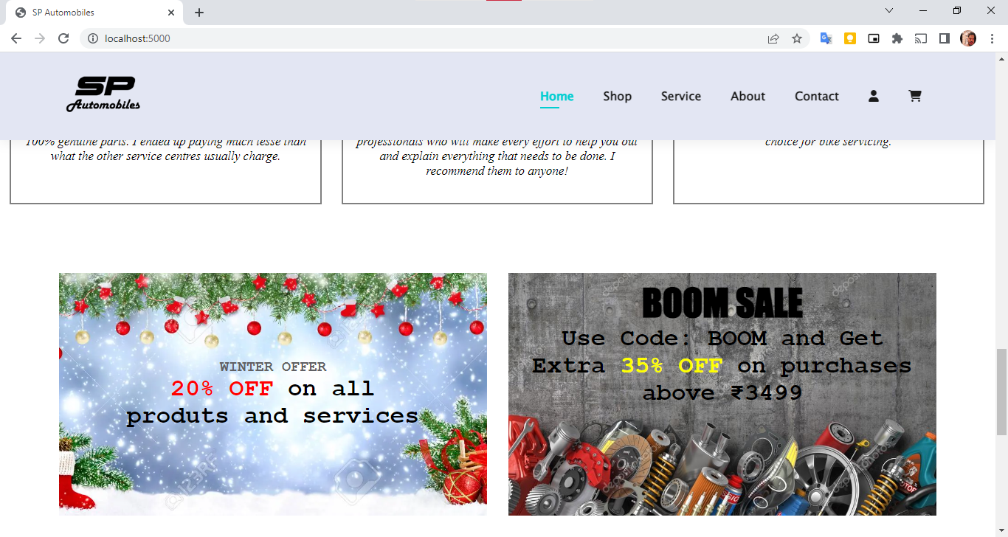
Home Page

Slide 19
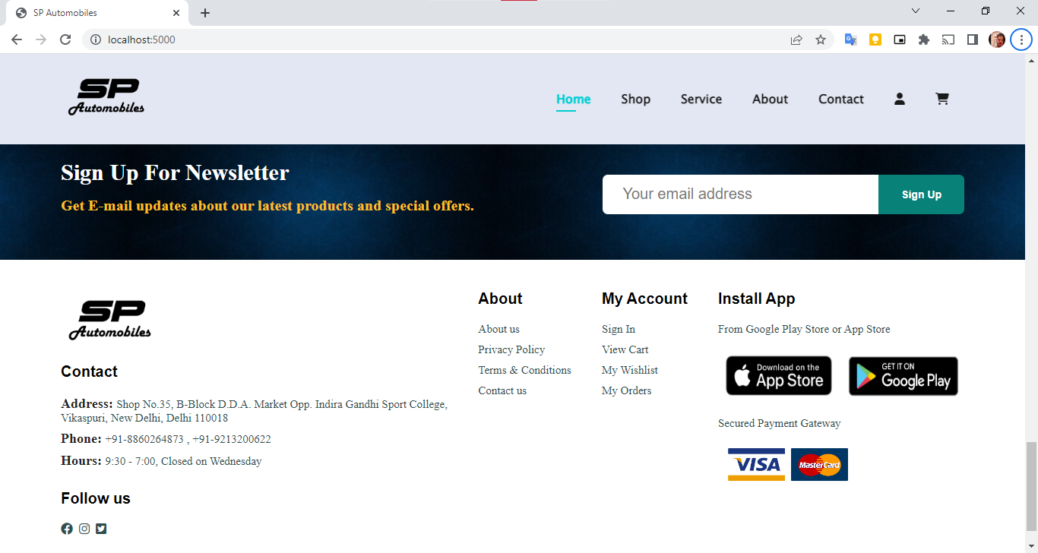
Home Page

Slide 20
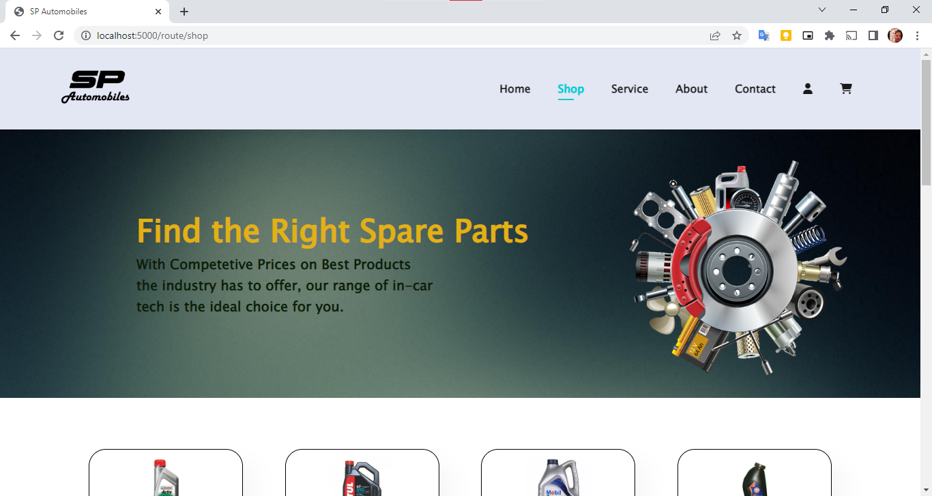
Shop Page

Slide 21
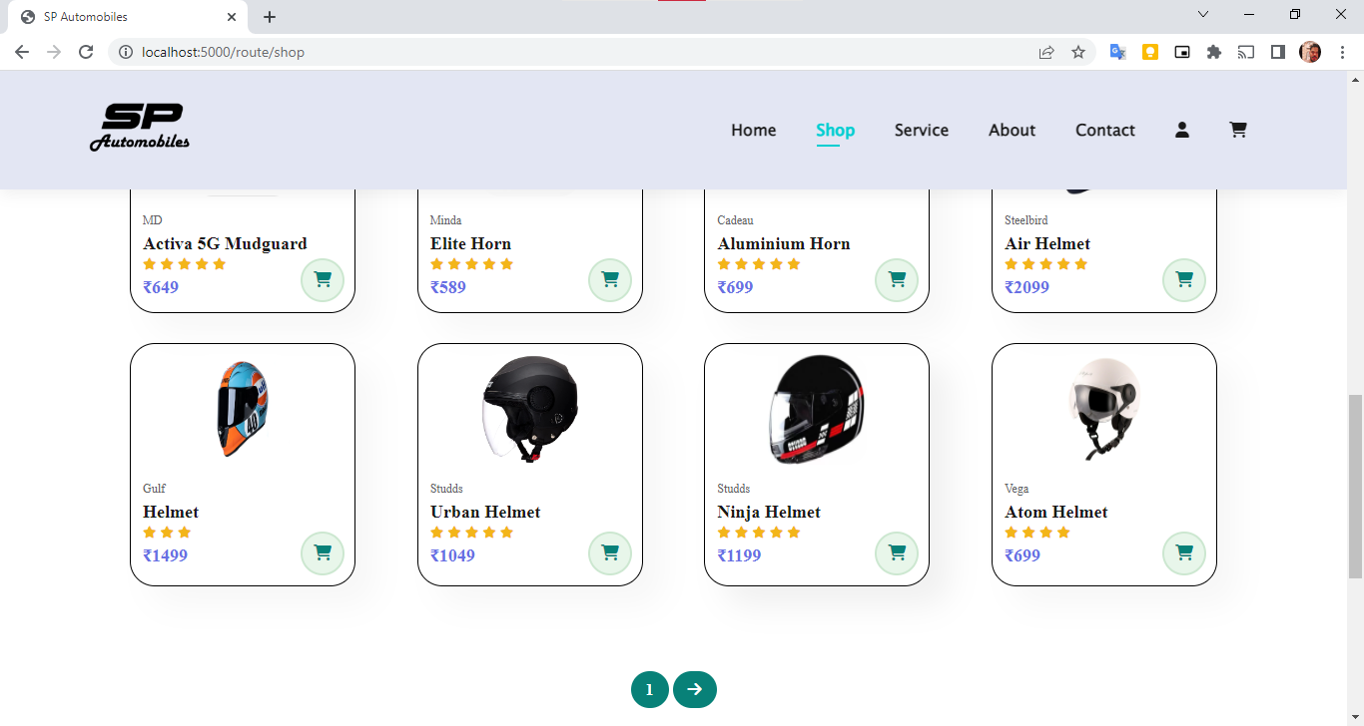
Shop Page

Slide 22
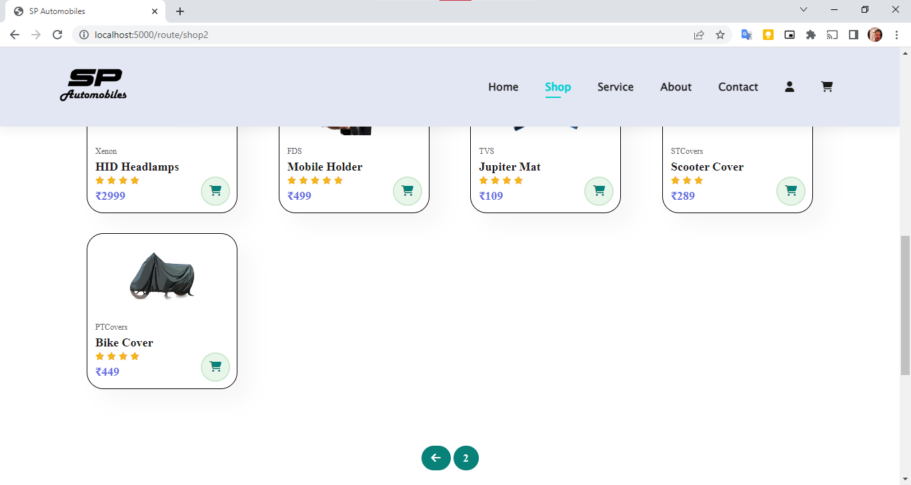
Shop Page

Slide 23
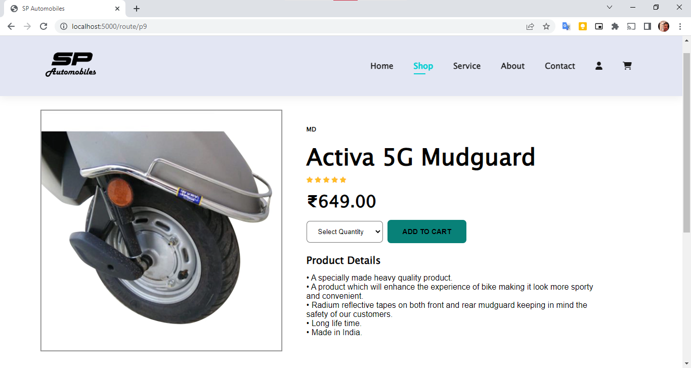
Single Product Page

Slide 24
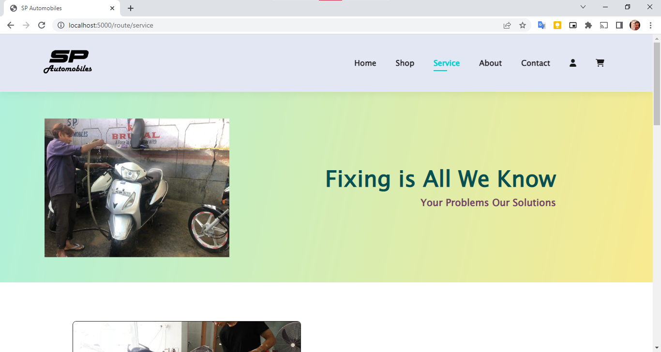
Service Page

Slide 25
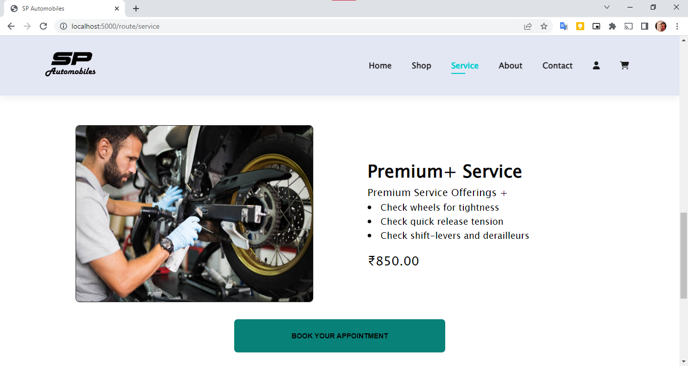
Service Page

Slide 26
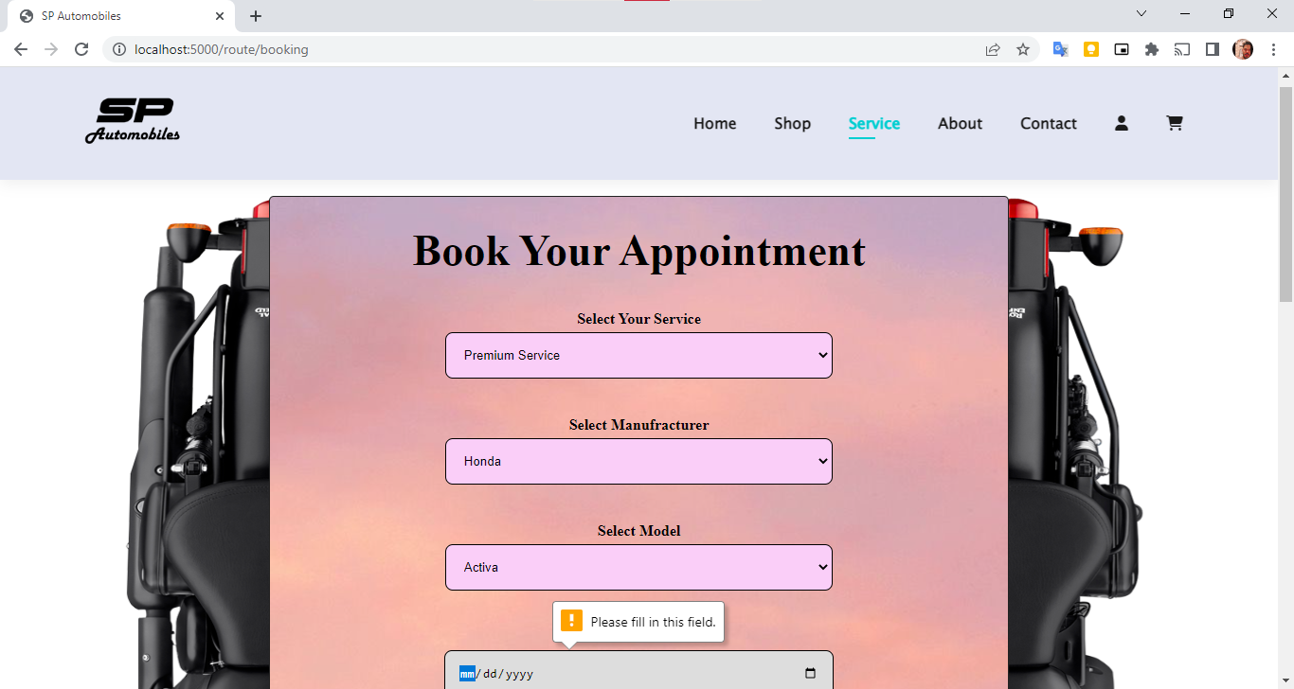
Booking Page

Slide 27
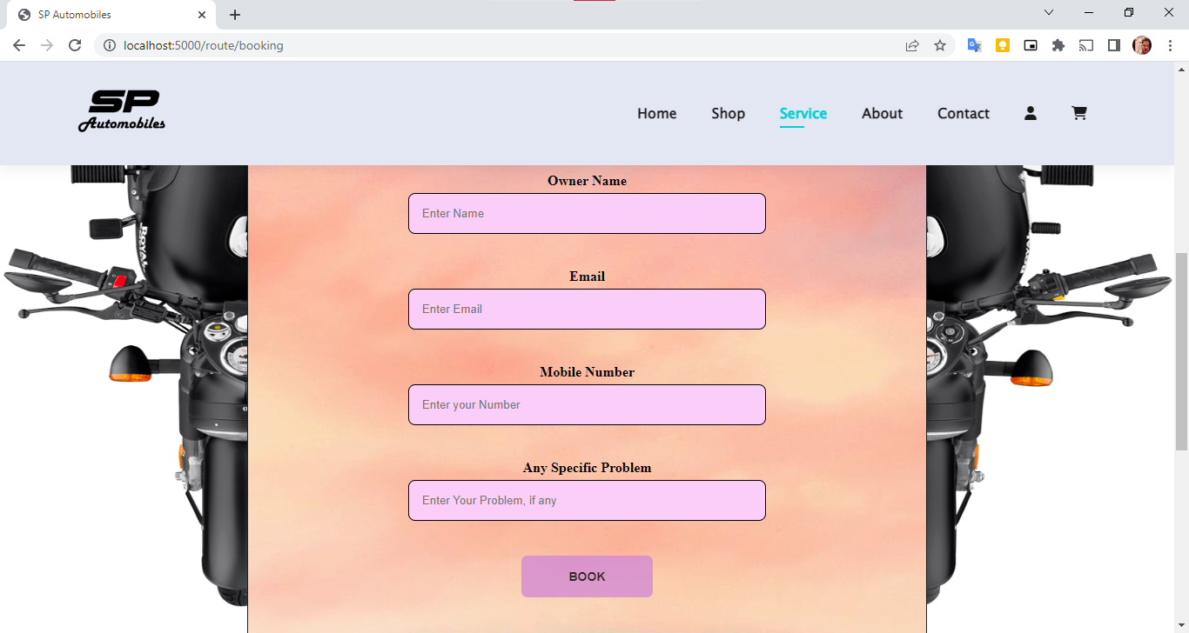
Booking Page

Slide 28
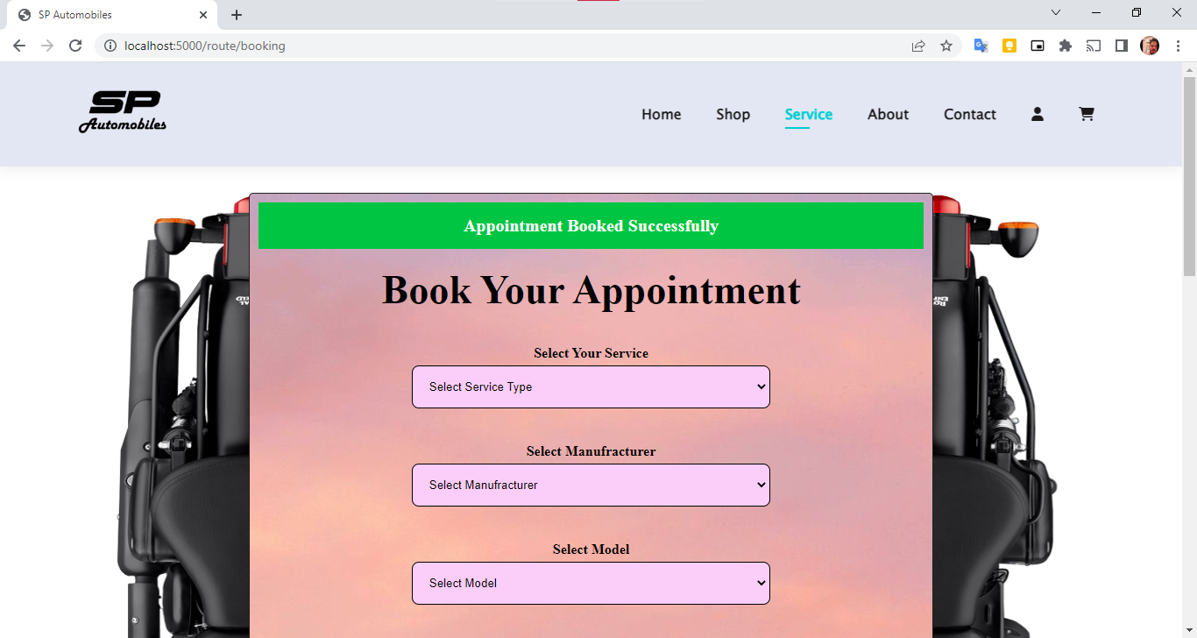
Booking Page

Slide 29
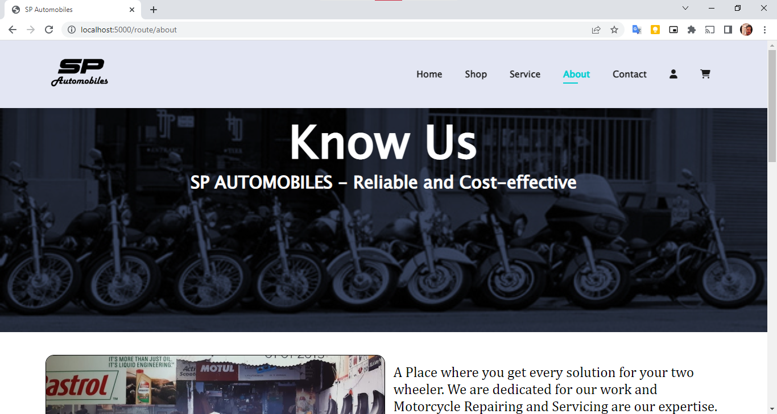
About Page

Slide 30
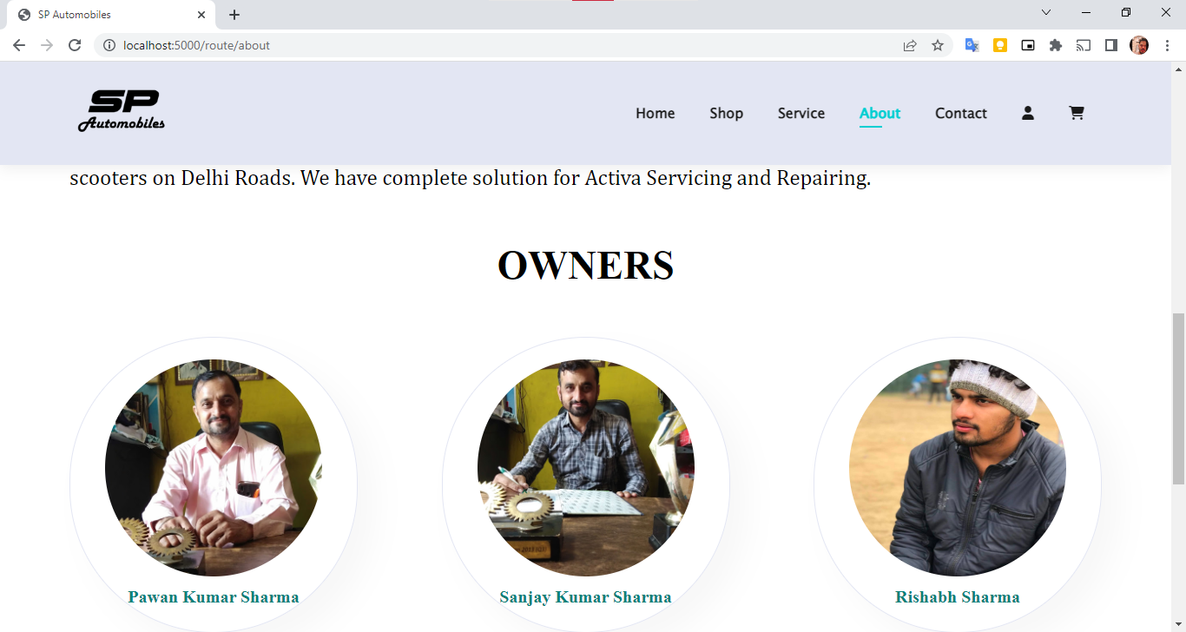
About Page

Slide 31
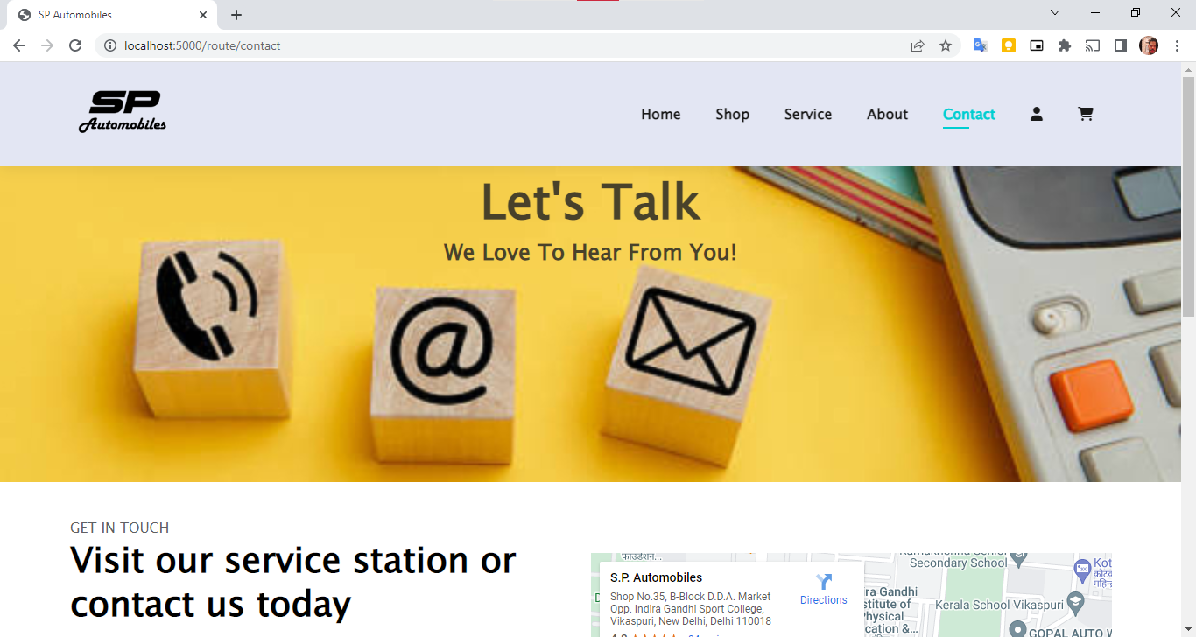
Contact Page

Slide 32
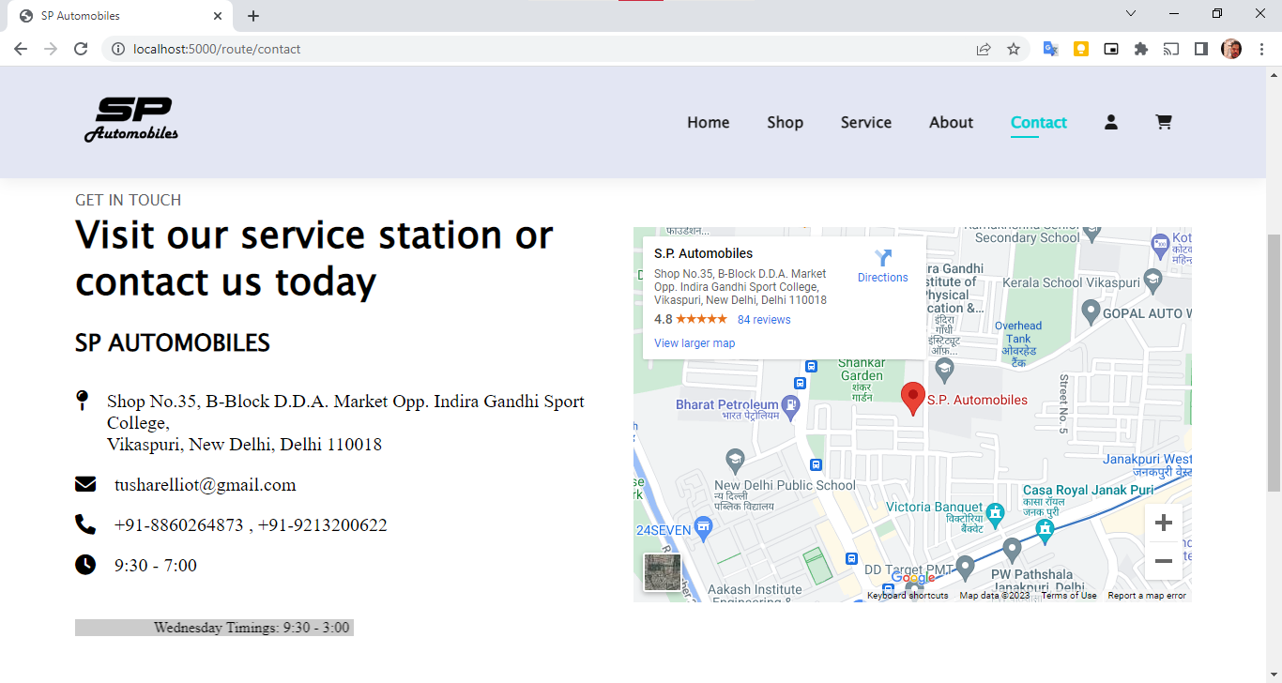
Contact Page

Slide 33
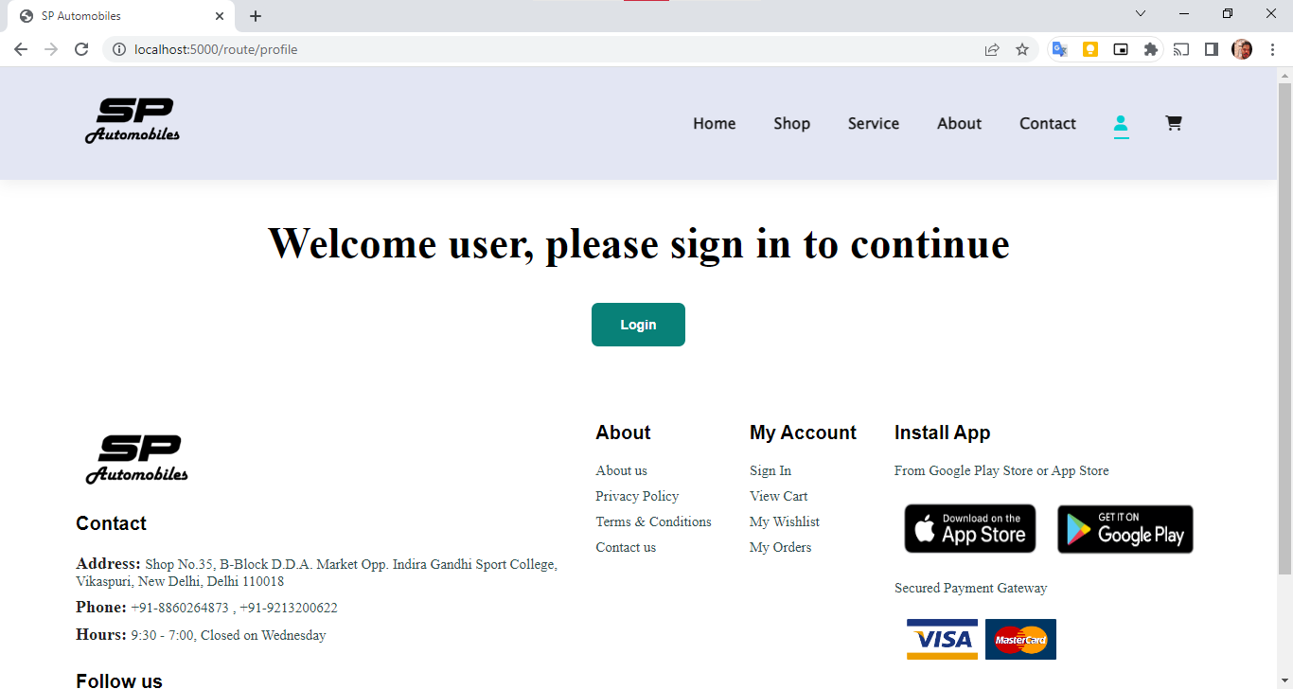
Profile Page

Slide 34
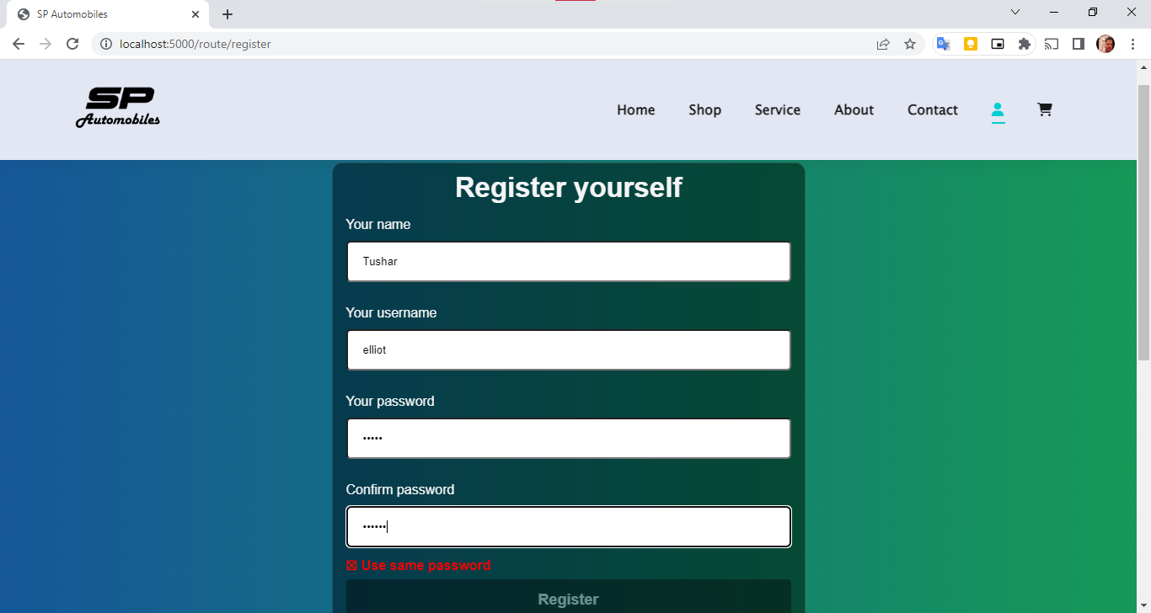
Profile Page

Slide 35
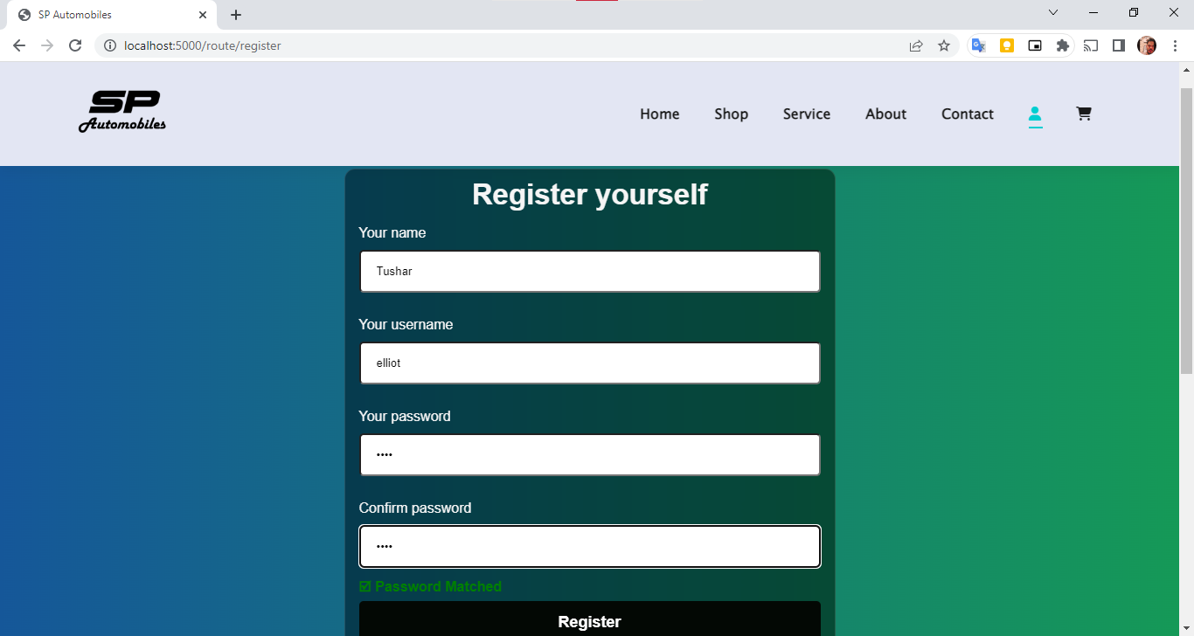
Profile Page

Slide 36
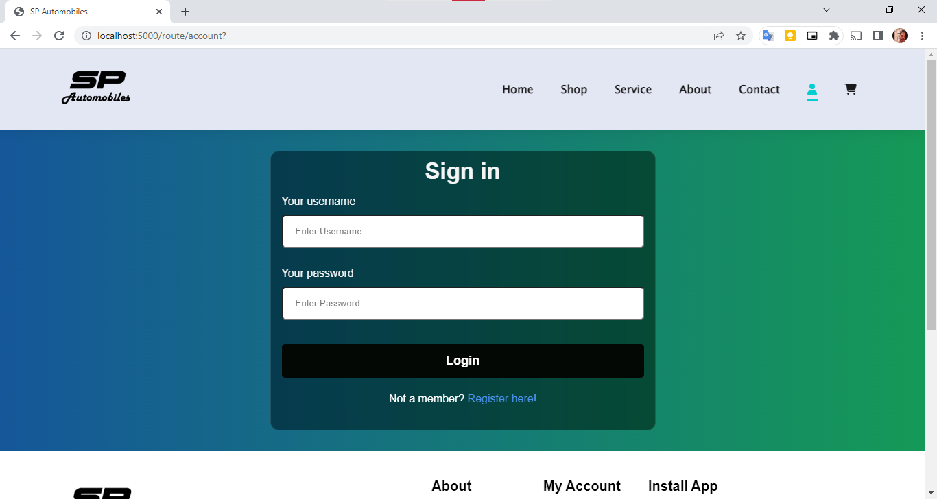
Profile Page

Slide 37
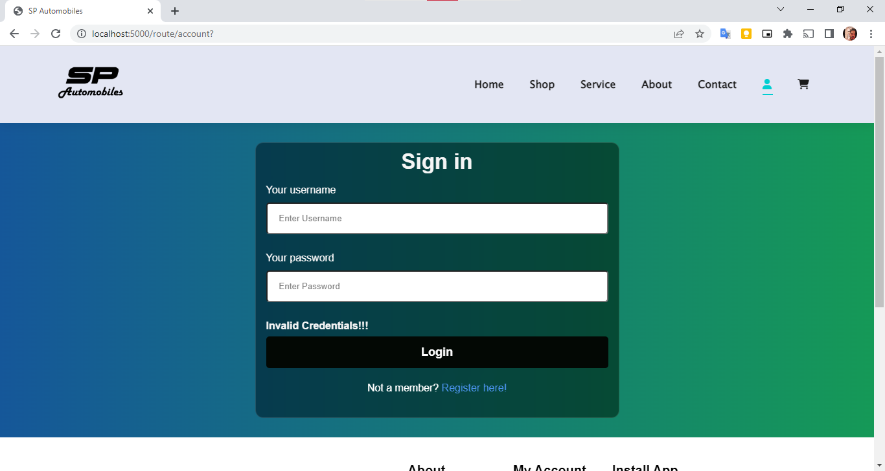
Profile Page

Slide 38
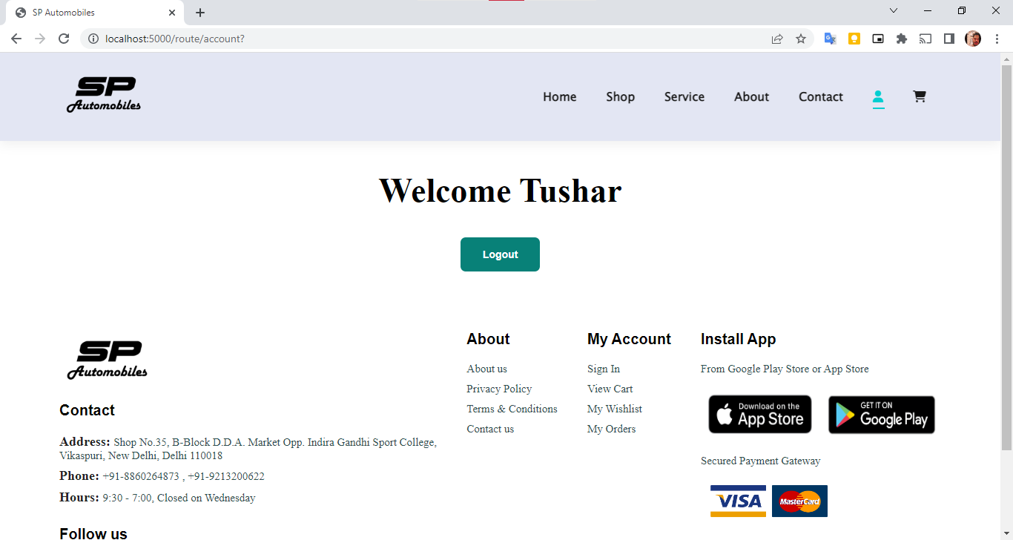
Profile Page

Slide 39
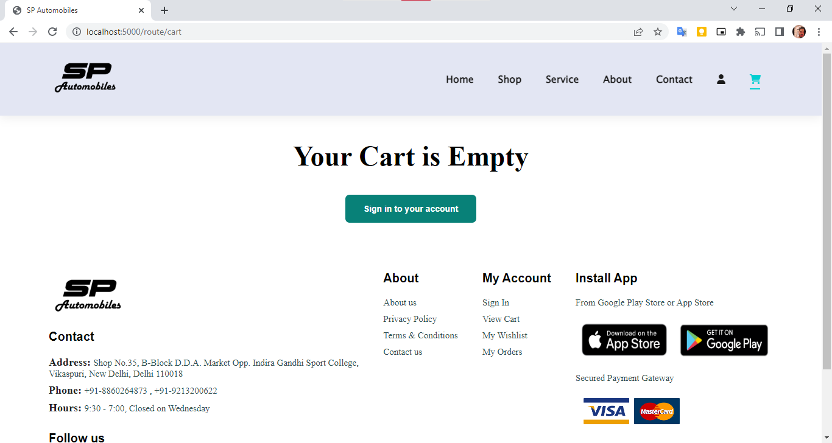
Cart

Slide 40
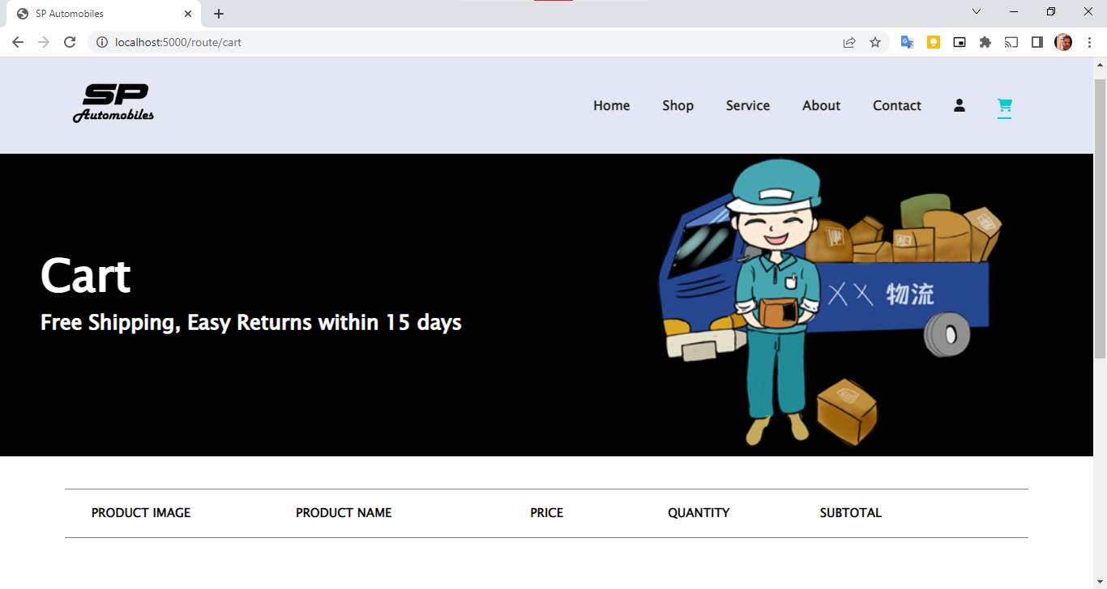
Cart

Slide 41
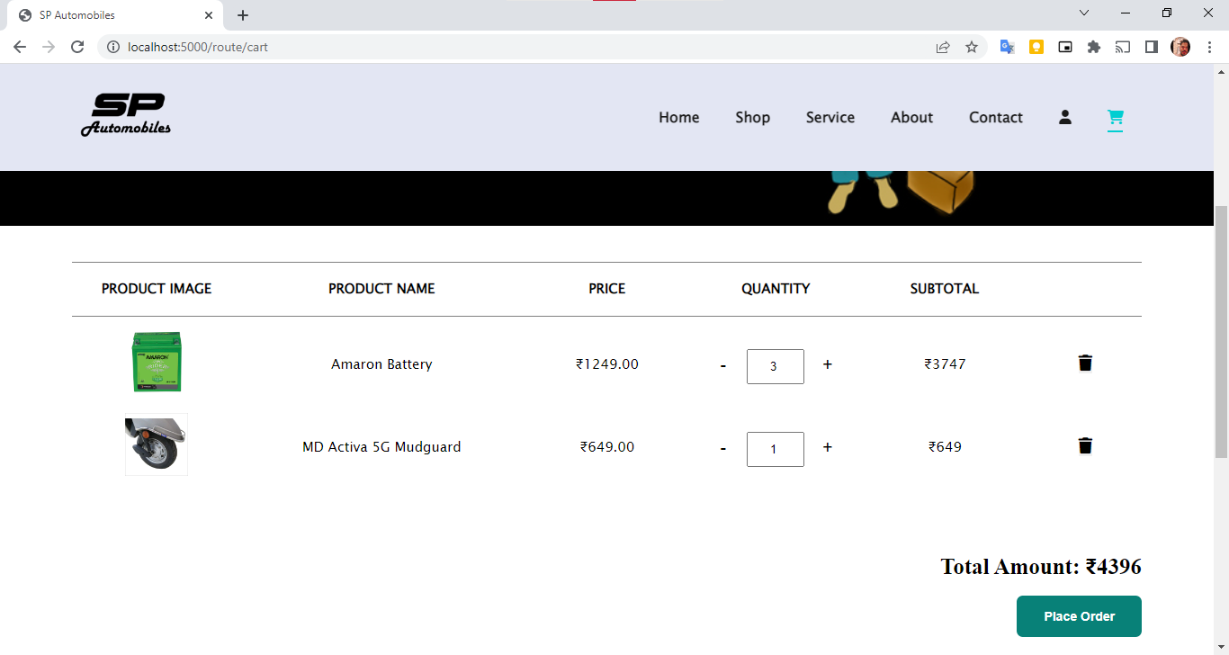
Cart

Slide 42
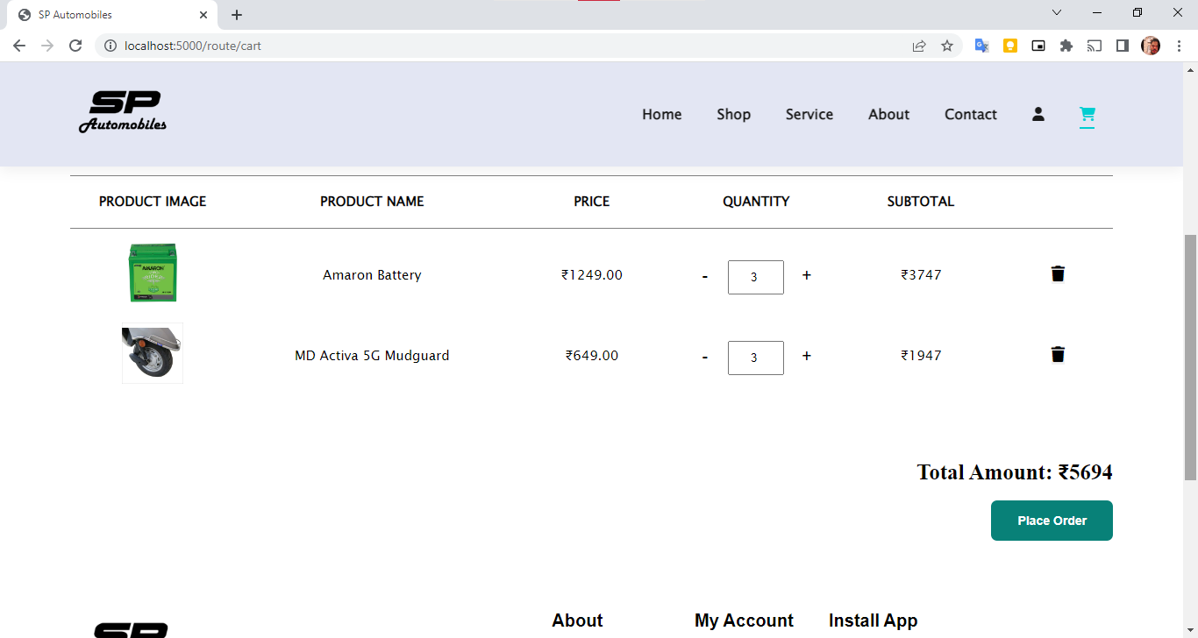
Cart

Slide 43
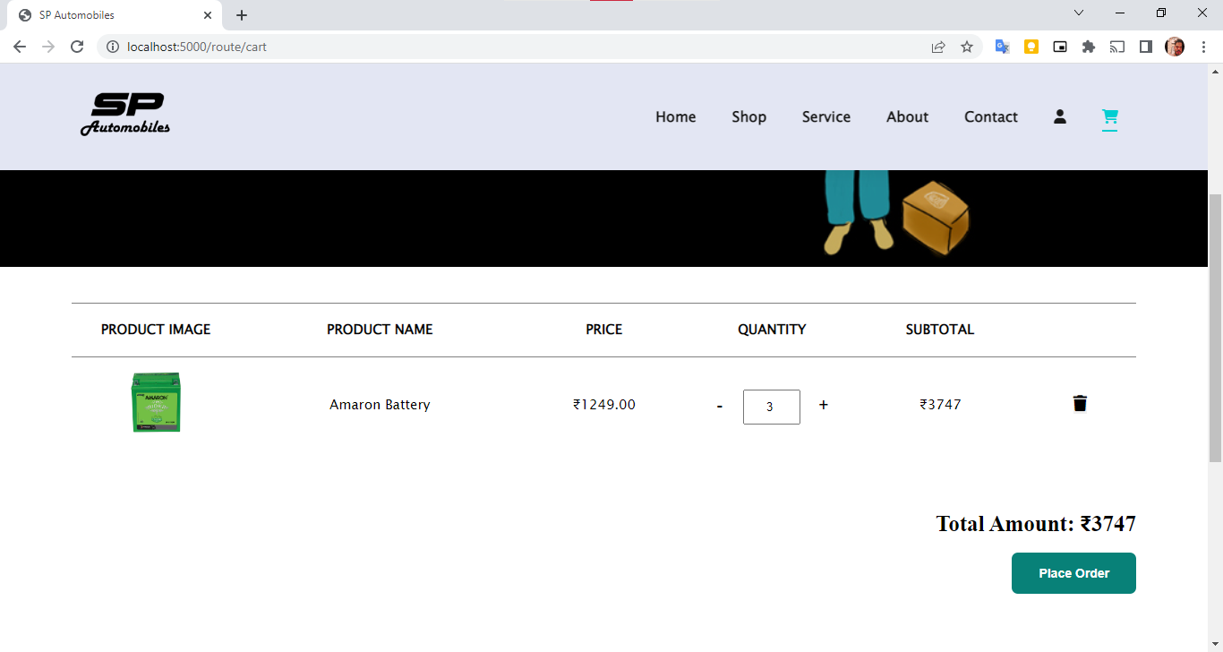
Cart

Slide 44
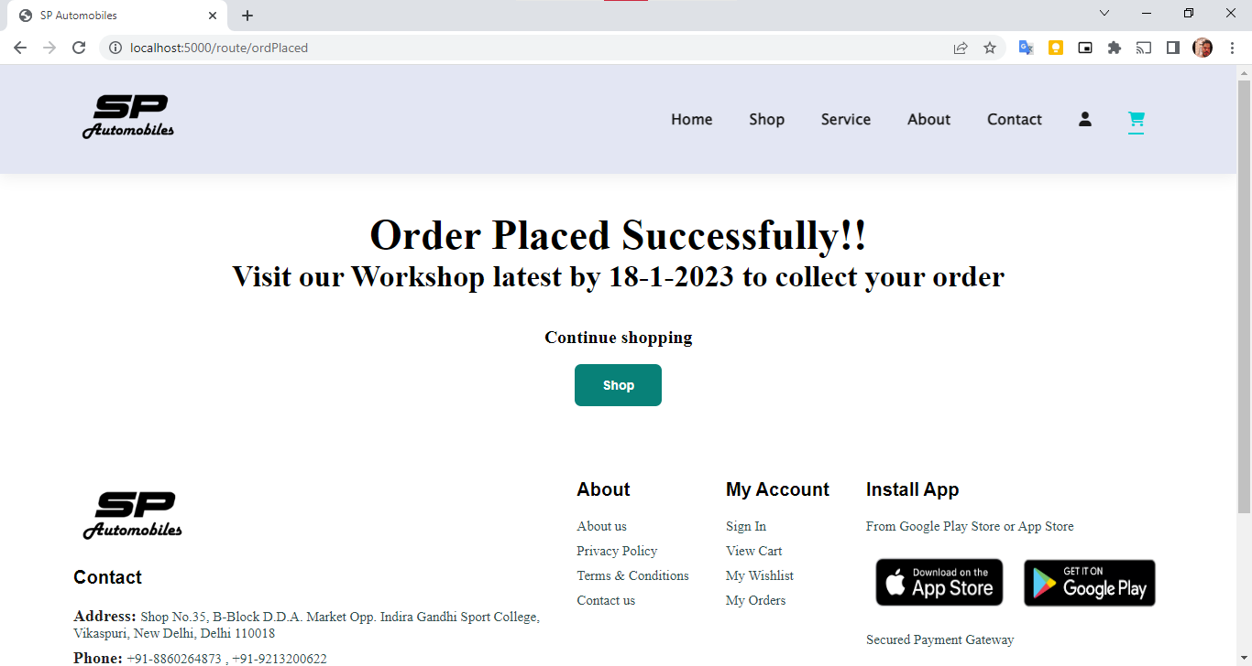
Place Order

Slide 45
Testing of the Project
Id | Test Case Description | Test Case Input | Test Results |  | Status | Corrective Measure
 |  |  | Expected | Actual
1 | When user try to book appointment without filling out details. | Some fields of the form are empty | Please fill details message. | Please fill details message. | Pass | None
2 | When user try to add items to cart without logging in | Add to cart. | Redirect to cart page with msg:”cart is empty” | Redirect to cart page with msg:”cart is empty” | pass | None
3 | Register as user | Try adding different password | Add same password | Add same password | Pass | None
4 | If user is registered and try add wrong credentials to login | Details of the user | Invalid Credentials | Invalid Credentials | Pass | None

Slide 46
Conclusion
A web-based application developed to book service and buy spare parts for vehicles in real time environment.
Agile Methodology has been followed for development of the project.
The developed application has following features:
Online accessibility.
Responsive user-friendly interfaces to interact with the system.
Other features as per the project’s nature.

Slide 47
Future Scope
Multi-language support can be provided for different regional customers.
Profile page section will get a complete overhaul and many new features will be added.
The developed project will be converted to a smart phone application.
We can provide our users with a better interface of our application.
Location service can be implemented.

Slide 48
Bibliography
Websites:
w3schools.com
javatpoint.com
geeksforgeeks.com
youtube.com

